Slide 1
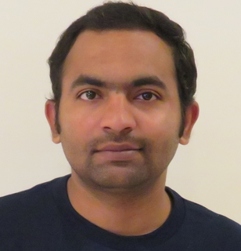

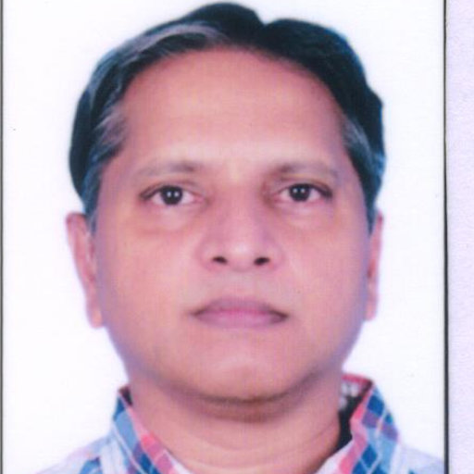
Bridging Language in Machines and Language in the Brain
Subba Reddy Oota^{1,2,3}, Mounika Marreddy⁴, Raju S. Bapi⁵
¹Inria Bordeaux, France; ²MPI for Software Systems, Germany; ³TU Berlin, Germany,
⁴University of Bonn, Germany; ⁵IIIT Hyderabad, India;
subba-reddy.oota@inria.fr, mmarredd@uni-bonn.de, raju.bapi@iiit.ac.in

Slide 2
Schedule
10.00 AM – 11.15 AM | Prof. Bapi S. Raju | Neuro-AI alignment: Introduction
11.15 AM – 11.45 AM | Coffee Break
11.45 AM – 1.00 PM | Dr. Marreddy Mounika | Recent trends in LLMs
1.00 PM – 2.30 PM | Lunch Break
2.30 PM – 3.45 PM | Dr. Subba Reddy Oota | Similarities and differences between language processing in brains and machines
3.45 PM – 4.15 PM | Coffee Break
4.15 PM – 5.30 PM | Dr. Subba & Dr. Mounika | Hands-on-session

Slide 3
Agenda
Neuro-AI alignment: Introduction [1 hour 15 min]
Introduction to Brain encoding and decoding [30 min]
Types of Brain Recordings [15 min]
Types of Stimulus Representations [30 min]
Coffee break [30 min]
Recent Trends in LLMs [1 hour 15 min]
Small language models [20 min]
Emerging abilities of language models [15 min]
Text-to-Text Transfer Transformer, Prompting, Instruction-tuning [40 min]
Lunch break [1 hour 30 min]
Language and Brain: Deep Learning for Brain Encoding and Decoding [1 hour 30 min]
Linguistic Brain Encoding [45 min]
Linguistic Brain Decoding [30 min]
Coffee break [30 min]
Hands-on-session [1 hour 15 min]

Slide 4
Agenda
Neuro-AI alignment: Introduction [1 hour 15 min]
Introduction to Brain encoding and decoding [30 min]
Types of Brain Recordings [15 min]
Types of Stimulus Representations [30 min]
Coffee break [30 min]
Recent Trends in LLMs [1 hour 15 min]
Small language models [20 min]
Emerging abilities of language models [15 min]
Text-to-Text Transfer Transformer, Prompting, Instruction-tuning [40 min]
Lunch break [1 hour 30 min]
Language and Brain: Deep Learning for Brain Encoding and Decoding [1 hour 30 min]
Linguistic Brain Encoding [45 min]
Linguistic Brain Decoding [30 min]
Coffee break [30 min]
Hands-on-session [1 hour 15 min]

Slide 5
Agenda
Neuro-AI alignment: Introduction [1 hour 15 min]
Introduction to Brain encoding and decoding [30 min]
Types of Brain Recordings [15 min]
Types of Stimulus Representations [30 min]
Coffee break [30 min]
Recent Trends in LLMs [1 hour 15 min]
Small language models [20 min]
Emerging abilities of language models [15 min]
Text-to-Text Transfer Transformer, Prompting, Instruction-tuning [40 min]
Lunch break [1 hour 30 min]
Language and Brain: Deep Learning for Brain Encoding and Decoding [1 hour 30 min]
Linguistic Brain Encoding [45 min]
Linguistic Brain Decoding [30 min]
Coffee break [30 min]
Hands-on-session [1 hour 15 min]

Slide 6
LMs are trained to predict missing words
jumps
Language model
The
quick
brown
fox
[MASK]
Notes:
These language models are trained to [Keep clicking]
predict missing words over millions of text documents.

Slide 7
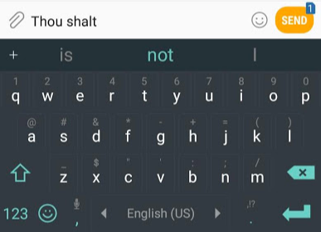
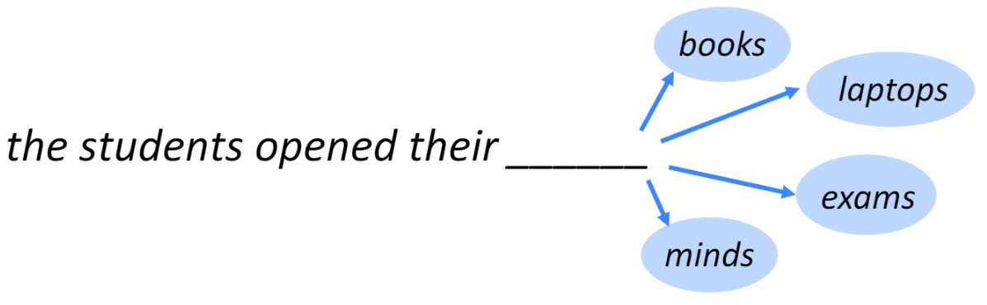
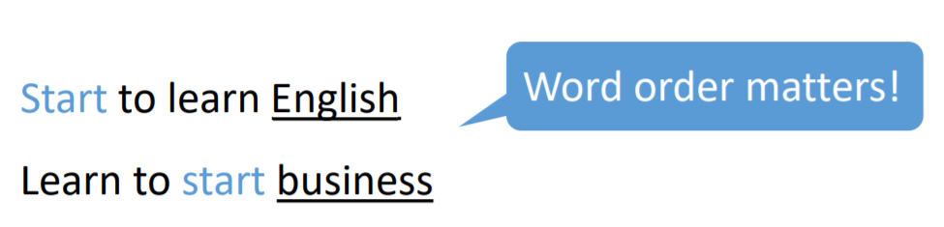
Background
Language Model?
Task of predicting what word comes next
Notes:
What a language model is – basically a machine learning model that is able to look at part of a sentence and predict the next word.
The most famous language models are smartphone keyboards that suggest the next word based on what you’ve currently typed.
Have you noticed the ‘Smart Compose’ feature in Gmail that gives auto-suggestions to complete sentences while writing an email?

Slide 8
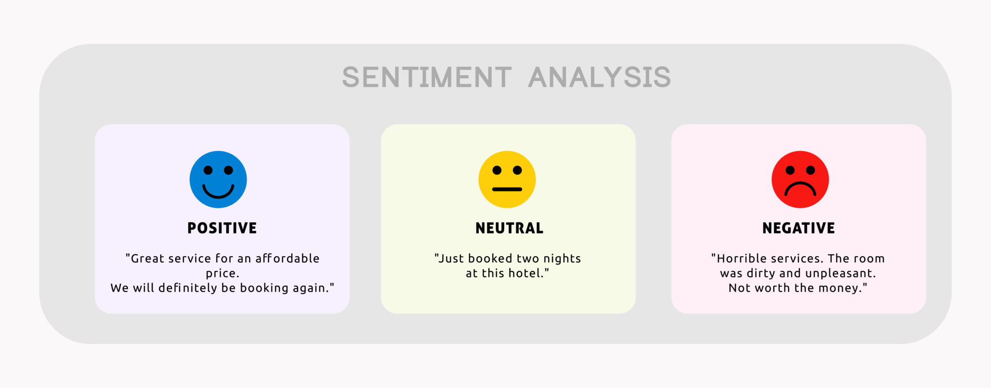
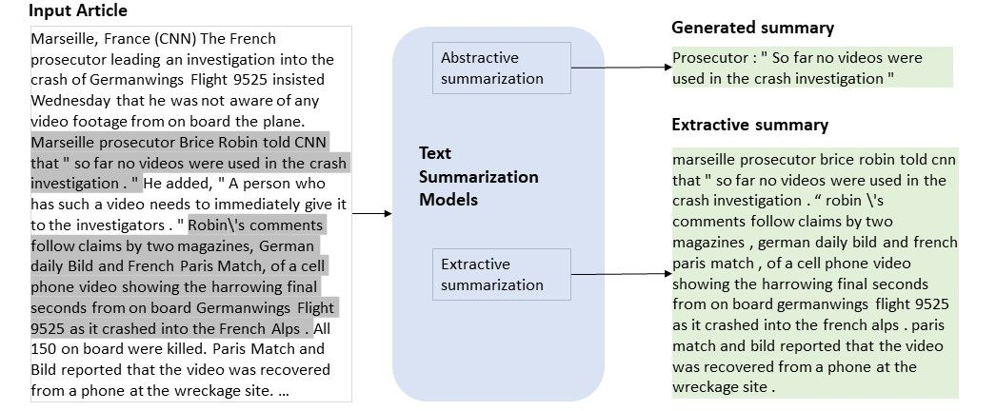
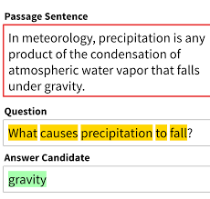
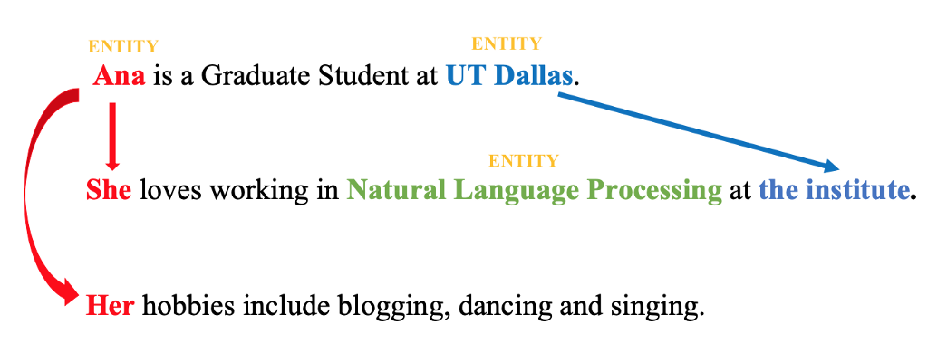
Language models are everywhere
Sentiment
Summarization
Question Answering
Coreference Resolution

Slide 9
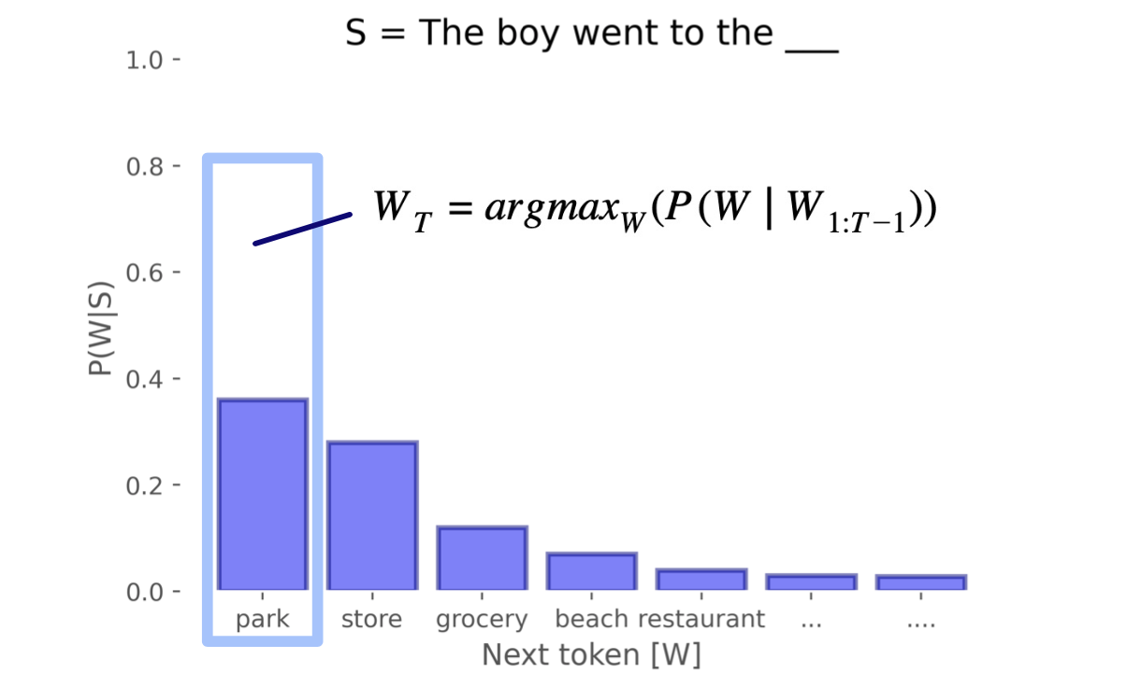
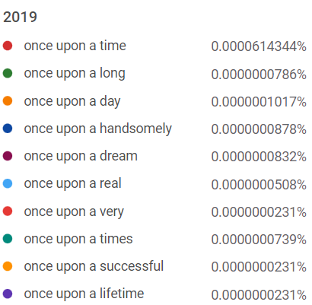
Statistical Language Models
The goal of statistical language modelling is to calculate the probability distribution over sequence of words.
?
Notes:
There are primarily two types of language models:
The probability of the next word can be estimated given only the previous k number of words.
If n=4, a gram may look like: “can you help me”. Basically, ‘n’ is the amount of context that the model is trained to consider. There are different types of N-Gram models such as unigrams, bigrams, trigrams, etc.

Slide 10
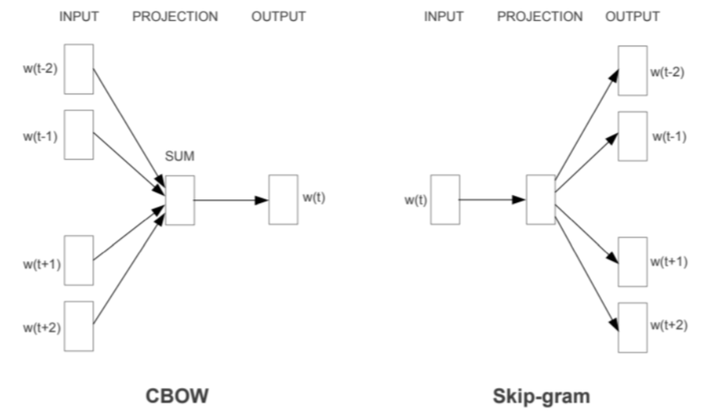
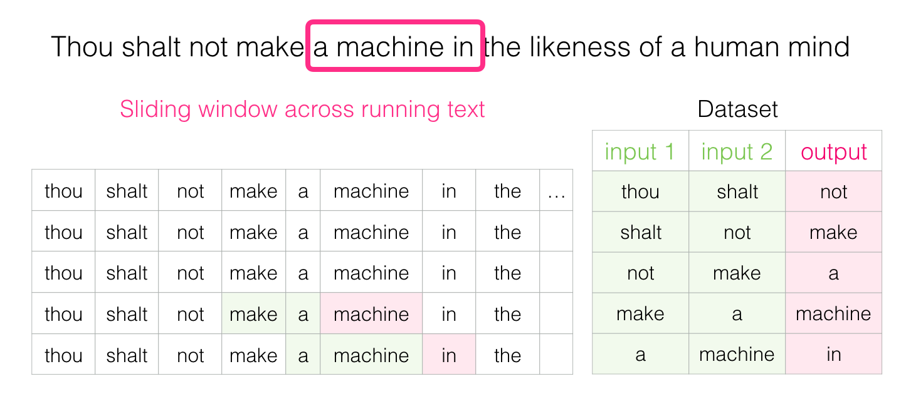

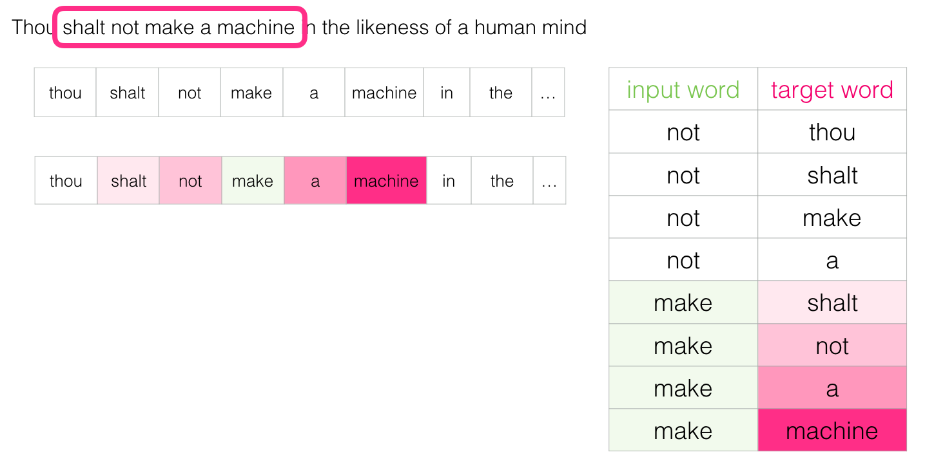
Neural Language Models
Word2Vec
Learns distributed representations of words.
Continuous bag-of-words (CBOW): Predicts current word from a window of surrounding context words.
Continuous skip-gram: Uses current word to predict surrounding window of context words.
Similar models such as GloVe, FastText
Tomas Mikolov, Kai Chen, Greg Corrado, Jeffrey Dean. Efficient Estimation of Word Representations in. NIPS 2013
Notes:
These language models are based on neural networks and are often considered as an advanced approach to execute NLP tasks.
Neural language models overcome the shortcomings of classical models such as n-gram and are used for complex tasks such as speech recognition or machine translation.
Language is significantly complex and keeps on evolving. Therefore, more complex is the language model, better it would be at performing NLP tasks.

Slide 11
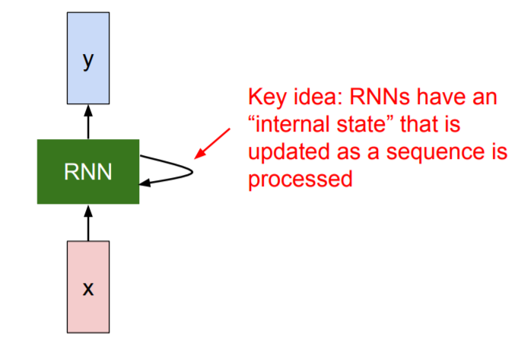
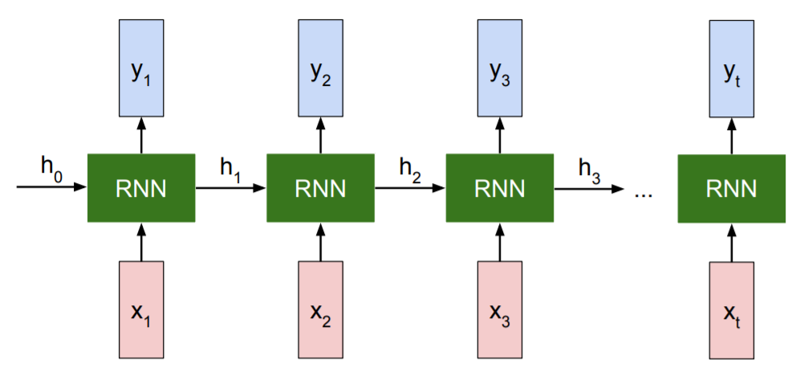
Seq2Seq models: RNNs
Initial hidden state
Rolled RNN
Unrolled RNN
Notes:
This unrolled network shows how we can supply a stream of data (intimately related to sequences, words and time-series data) to the recurrent neural network.
For instance, first we supply the word vector for “x1” to the network and also act as a stand-alone output ( h₀ ).
The next network (though it’s the same network) at time t=1 takes the next word vector for “x2” and the previous output h₀ into its hidden nodes, producing the next output h₁ and so on.

Slide 12
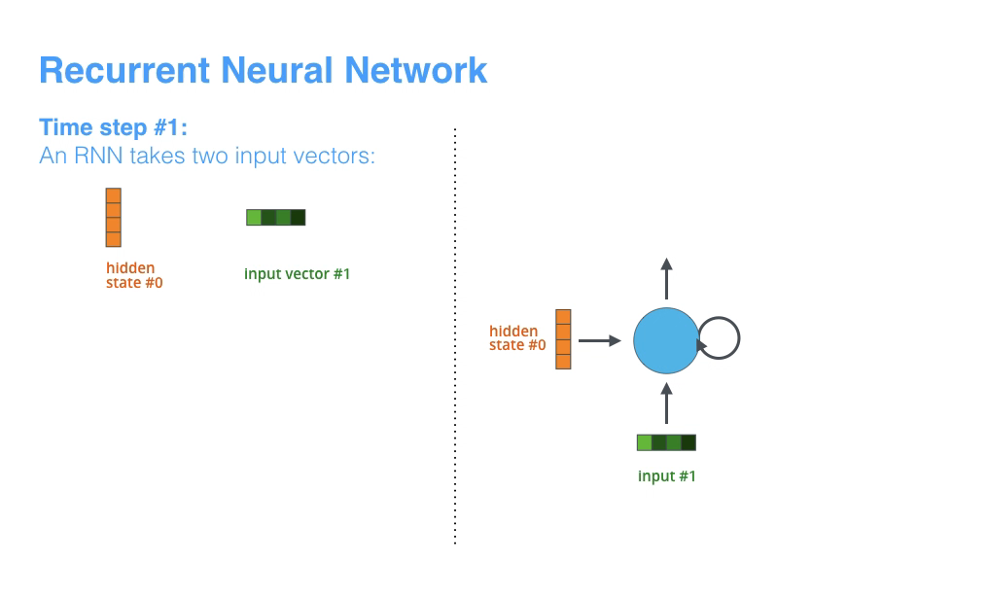
Seq2Seq models: RNNs
https://zhanghanduo.github.io
Notes:
This unrolled network shows how we can supply a stream of data (intimately related to sequences, words and time-series data) to the recurrent neural network.
For instance, first we supply the word vector for “x1” to the network and also act as a stand-alone output ( h₀ ).
The next network (though it’s the same network) at time t=1 takes the next word vector for “x2” and the previous output h₀ into its hidden nodes, producing the next output h₁ and so on.

Slide 13
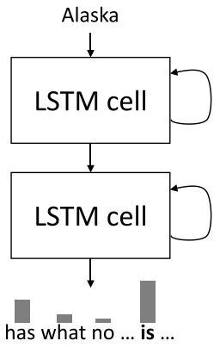
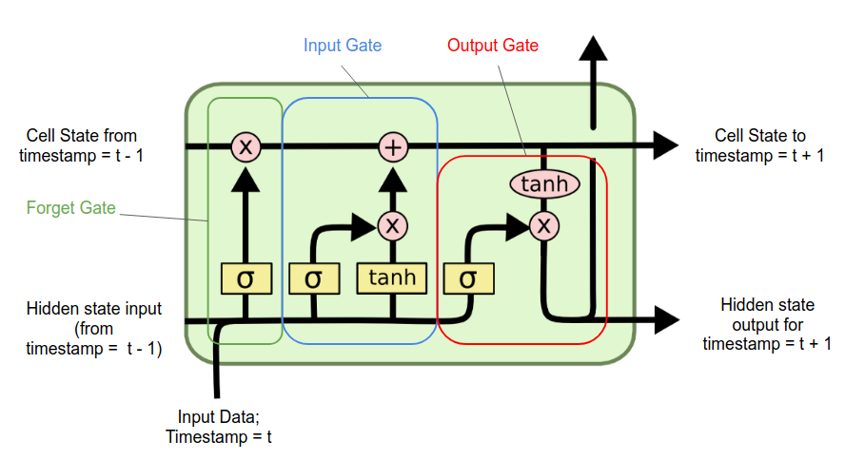
Seq2Seq models: LSTMs
Long Memory
Short
Memory
LSTM
S Hochreiter, J Schmidhuber . Long short-term memory in. Neural Computation 1997

Slide 14
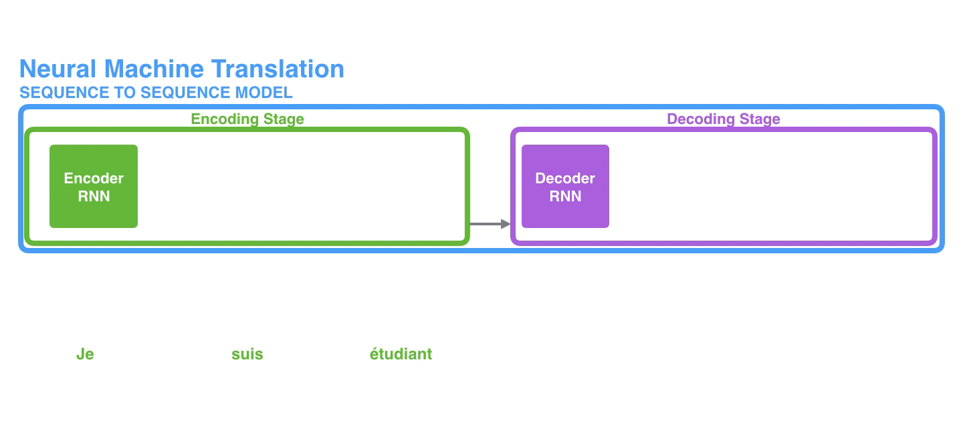
Seq2Seq Learning with RNNs
The model is comprised of two sub-models:
Encoder: The encoder is responsible for stepping through the input time steps and encoding the entire sequence into a fixed length vector called a context vector.
Decoder: The decoder is responsible for stepping through the output time steps while reading from the context vector.
It has a serious problem when working with long sequences.
https://zhanghanduo.github.io
Notes:
The encoder vector is the last hidden state of the encoder, and it tries to contain as much of the useful input information as possible to help the decoder get the best results.
The information of the first tokens is lost or diluted as more tokens are processed.
The context vector has been given the responsibility of encoding all of the information in a given source sentence into a vector of few hundred elements.

Slide 15
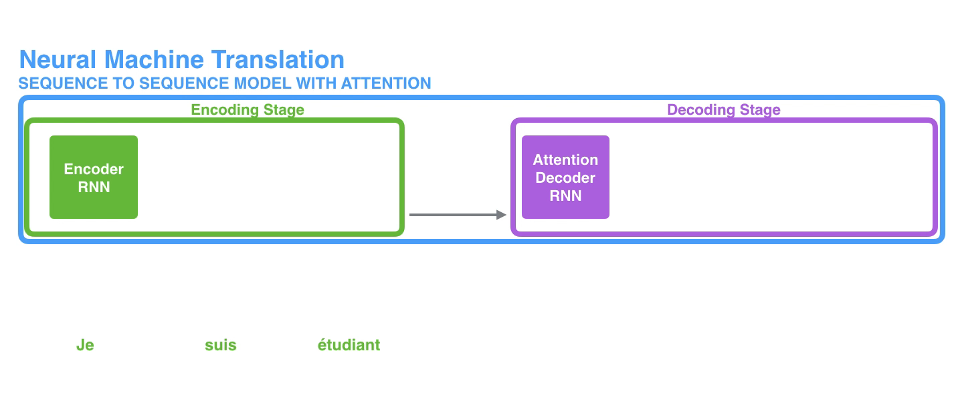
Seq2Seq Model with Attention
An attention model differs from a classic sequence-to-sequence model in two main ways
Instead of passing the last hidden state of the encoding stage, the encoder passes all the hidden states to the decoder.
Ian Tenney, Patrick Xia, Berlin Chen, Alex Wang, Adam Poliak, R Thomas McCoy, Najoung Kim, Benjamin Van Durme, Samuel R. Bowman, Dipanjan Das, Ellie Pavlick. What do you learn from context? Probing for sentence structure in contextualized word representations. ICLR 2019
Notes:
The context vector turned out to be a bottleneck for these types of models.
It made it challenging for the models to deal with long sentences.
Attention allows the model to focus on the relevant parts of the input sequence as needed.

Slide 16
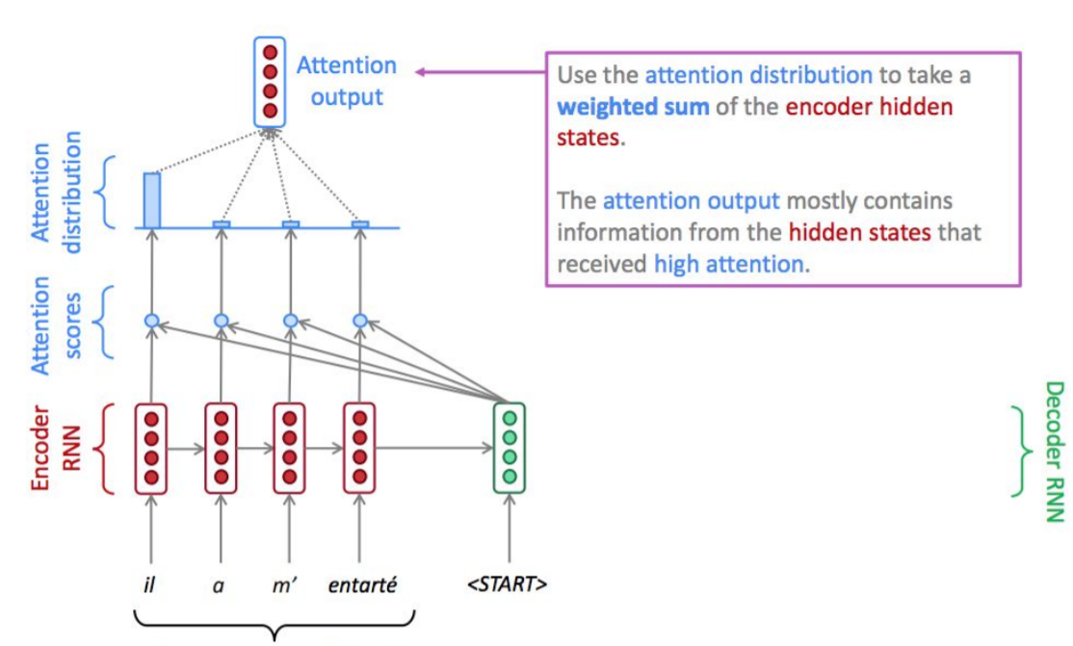
Seq2Seq with Attention
Notes:
Attention summarizes the encoder, focusing on specific parts/words.

Slide 17
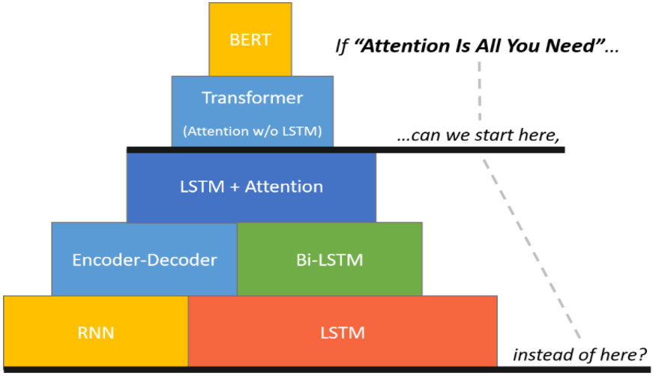
Attention is All You Need…..
http://www.chrismccormick.ai/

Slide 18
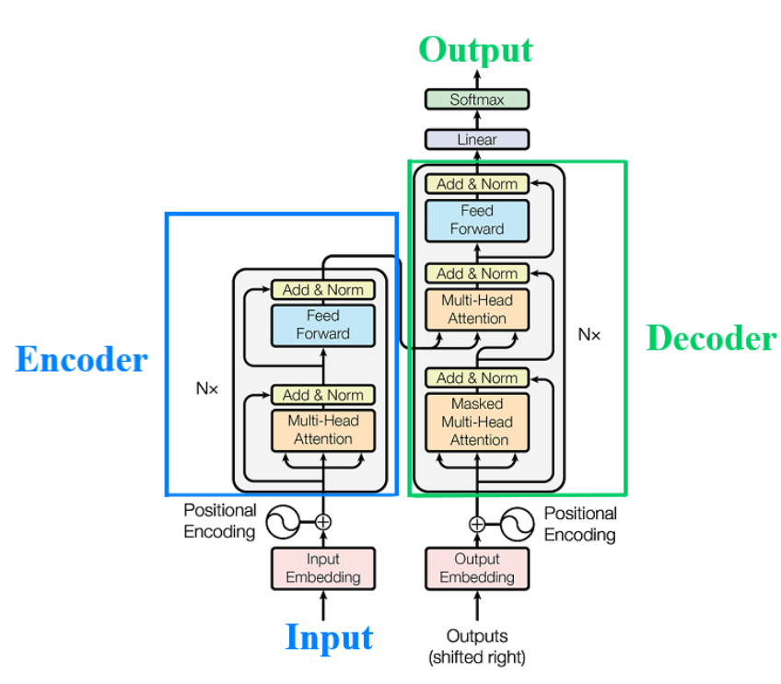
Transformers
Ashish Vaswani, Noam Shazeer. "Attention Is All You Need." NeurIPS (2017).
Notes:
It uses neither the convolutional neural networks (CNN) nor the recurrent neural networks (RNN) in its structure, but only the mechanism of attention.
The Transformer models all its dependencies using this mechanism.
The RNN and Seq2Seq models are difficult to parallelize and may have difficulty in learning long-range dependencies within the input and output sequences.
But this problem is solved with Transformer.

Slide 19
The Transformer's takeover:
One community at a time
Ashish Vaswani, Noam Shazeer. "Attention Is All You Need." NeurIPS (2017).
ICETCI 2024: DL for Brain Encoding and Decoding

Slide 20

Computer Vision
Natural Lang. Proc.
Reinf. Learning
Speech
Translation
Graphs/Science
Transformer image source: "Attention Is All You Need" paper

Slide 21
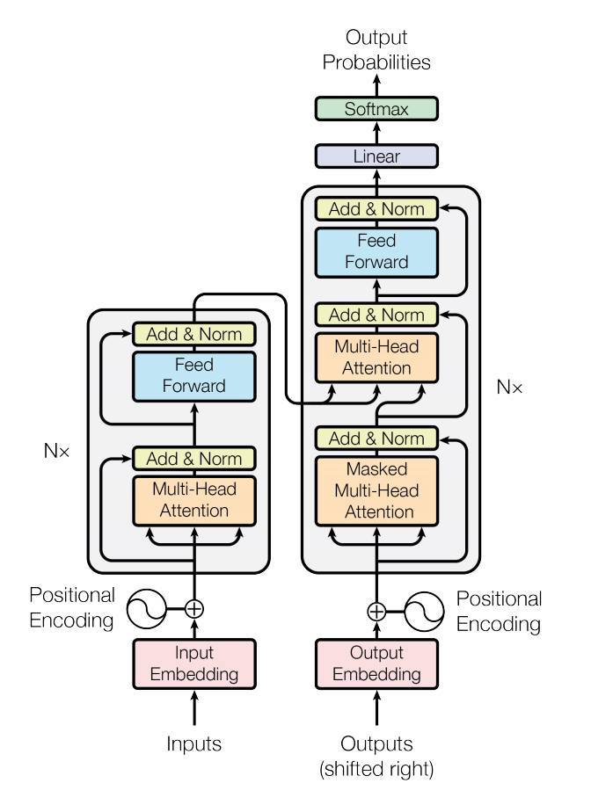
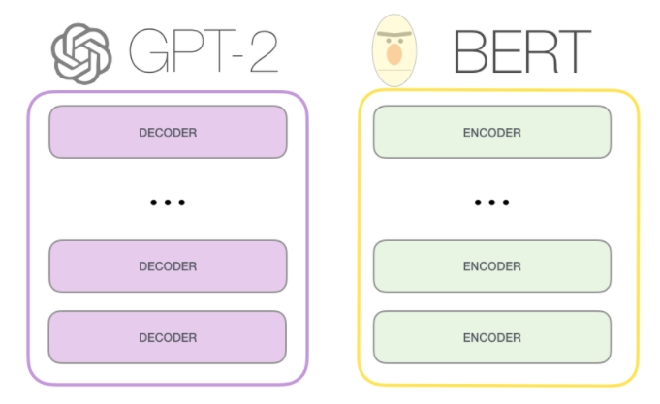
Transformer
Harry never thought he would
Harry never thought he ???
Ashish Vaswani, Noam Shazeer. "Attention Is All You Need." NeurIPS (2017).

Slide 22
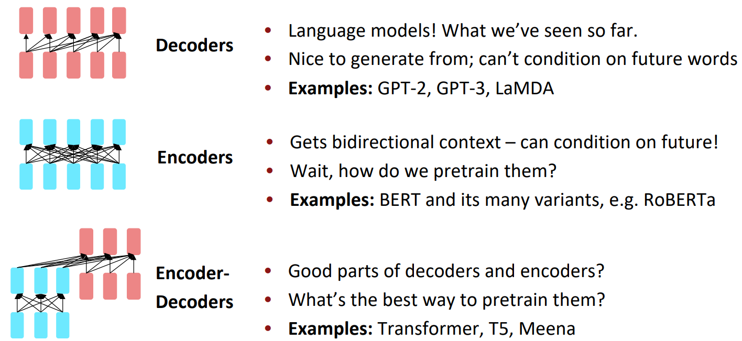
LLMs: Pretraining for three types of architectures
Ashish Vaswani, Noam Shazeer. "Attention Is All You Need." NeurIPS (2017).

Slide 23
Decoder-only
GPT
Encoder-only
BERT
Enc-Dec
T5
Das ist gut.
A storm in Attala caused 6 victims.
This is not toxic.
[sat_]
[*] [*] [sat_] [*] [the_] [*]
Translate EN-DE: This is good.
Summarize: state authorities dispatched…
Is this toxic: You look beautiful today!
[START] [The_] [cat_]
[The_] [cat_] [MASK] [on_] [MASK] [mat_]
Transformer image source: "Attention Is All You Need" paper

Slide 24
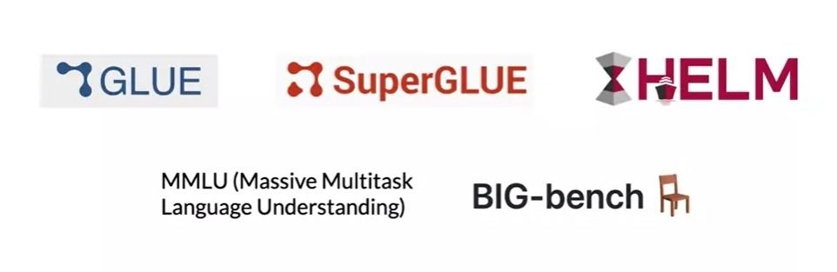
Language models are everywhere
Small language models
https://gluebenchmark.com/
https://super.gluebenchmark.com/
https://crfm.stanford.edu/helm/lite/latest/
https://paperswithcode.com/dataset/mmlu
https://paperswithcode.com/dataset/big-bench

Slide 25
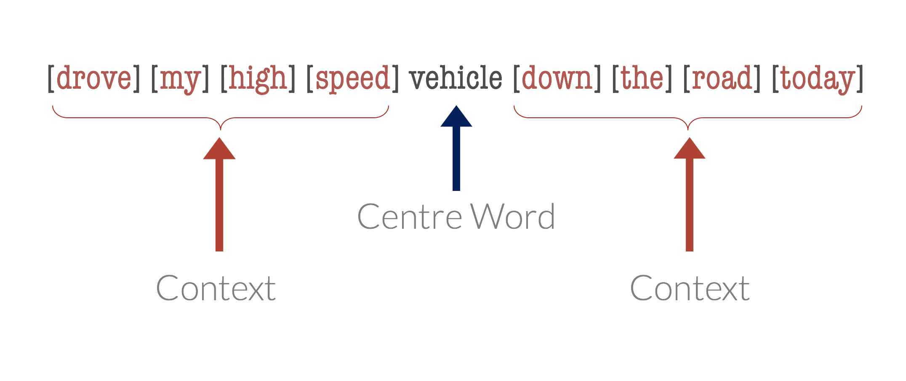
BERT: Workflow
1. Self-attention with Bi-directional context
w_{t-2}
w_{t-1}
w_{t}
w_{t+1}
w_{t+2}
[Context word]
[Context word]
Current word
[Context word]
[Context word]
2. Masked language modeling (MLM)
[MASK]

Slide 26
GPT2: Workflow
1. Self-attention with Uni-directional context
w_{t-2}
w_{t-1}
w_{t}
[Context word]
[Context word]
Current word
2. Causal language modeling (CLM)
[vehicle]
[MASK]
[vehicle]

Slide 27
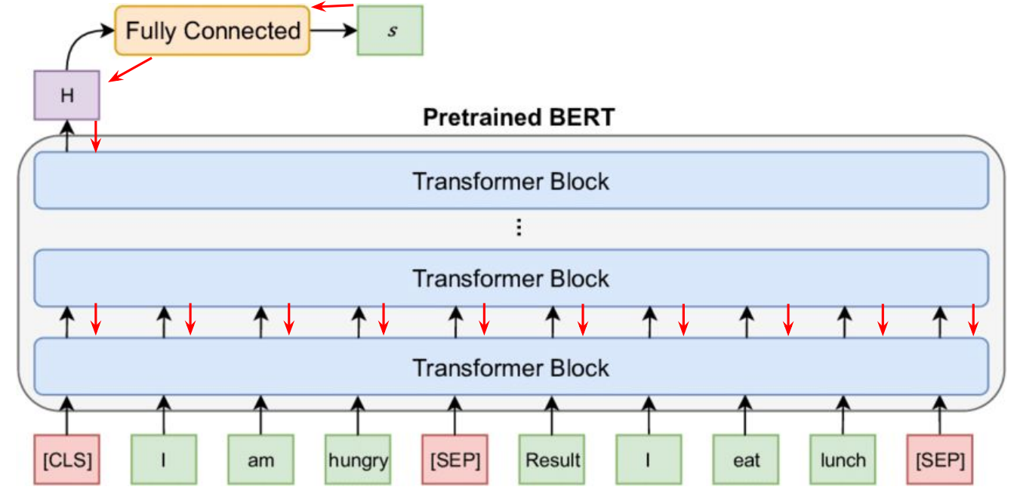
Fine tuning: tune pretrain language model on a task

Slide 28
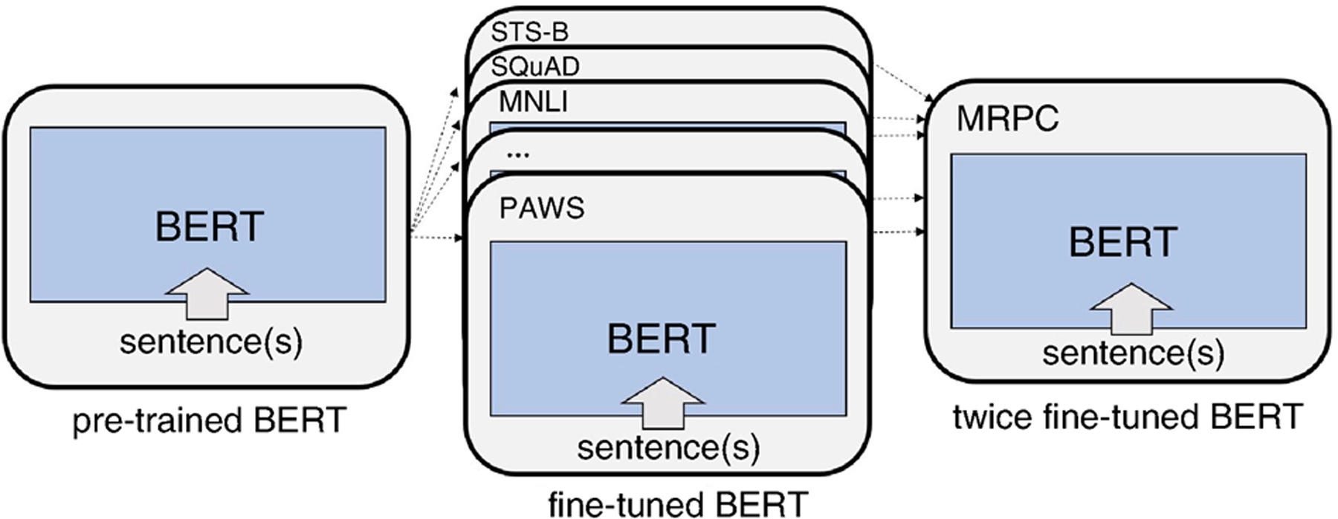
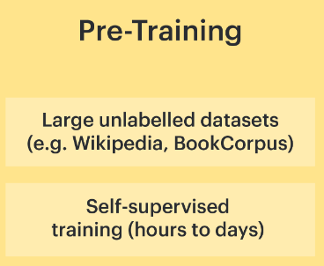
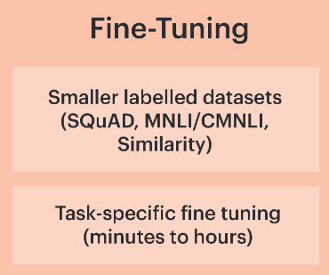
Task-specific language models
Jacob Devlin, Ming-Wei Chang, Kenton Lee, Kristina Toutanova. "BERT: Pre-training of Deep Bidirectional Transformers for Language Understanding" NAACL (2018).
Notes:
In this study, we investigate the correlation between brain activation and feature representa- tions learned by different task-specific networks, and ask which tasks lead to improvements in brain-encoding performance.
Our selection of these tasks was based on the following design principles:
(1) We wanted to select a set of tasks covering diverse cognitive-linguistic skills.
(2) We wanted to select tasks that are a part of popular NLP benchmarks like GLUE
The emerging evidence from fMRI studies both syntax and semantics is distributed in the brain Thus, in this work, we explore syntactic and semantic tasks separately. Of the above mentioned tasks, NER and SS are syntactic, while the others involve semantic reasoning.

Slide 29
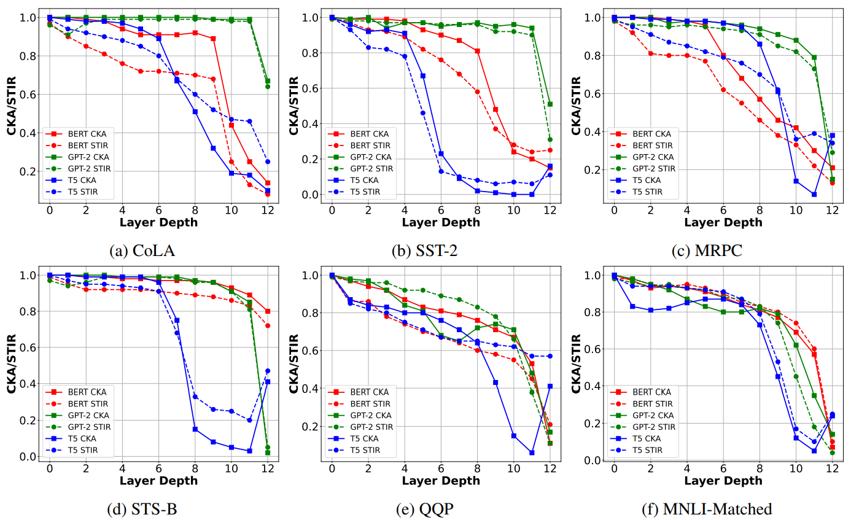
How does finetuning modify the layers representations for different models?
GPT-2 had fewer affected layers, indicating higher semantic stability.
CKA and STIR vary consistently across all three models.
Pavan Kalyan Reddy Neerudu, Subba Reddy Oota, Mounika Marreddy, Venkateswara Rao Kagita, Manish Gupta. On Robustness of Finetuned Transformer-based NLP Models. EMNLP 2023.

Slide 30
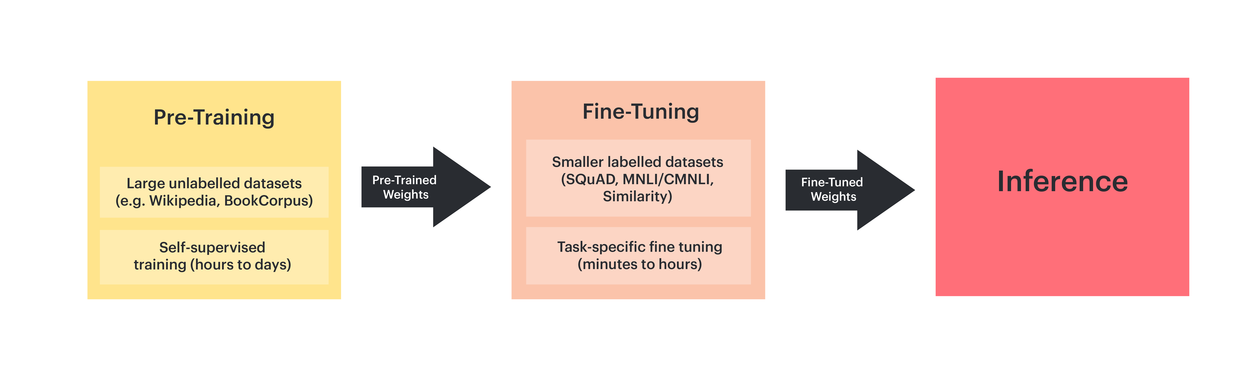
Downside of full fine tuning

Slide 31
Agenda
Neuro-AI alignment: Introduction [1 hour 15 min]
Introduction to Brain encoding and decoding [30 min]
Types of Brain Recordings [15 min]
Types of Stimulus Representations [30 min]
Coffee break [30 min]
Recent Trends in LLMs [1 hour 15 min]
Small language models [20 min]
Emerging abilities of language models [15 min]
Text-to-Text Transfer Transformer, Prompting, Instruction-tuning [40 min]
Lunch break [1 hour 30 min]
Language and Brain: Deep Learning for Brain Encoding and Decoding [1 hour 30 min]
Linguistic Brain Encoding [45 min]
Linguistic Brain Decoding [30 min]
Coffee break [30 min]
Hands-on-session [1 hour 15 min]

Slide 32
Analyzing and Interpreting LMs
Model Interpretability
Behavioural Interpretability
Mechanistic Interpretability
Analysis of representations via probing
Bridging language models and brain
Robustness
Reverse engineering of neural computations
"BlackboxNLP: Analyzing and Interpreting Neural Networks for NLP" 2023 EMNLP.

Slide 33
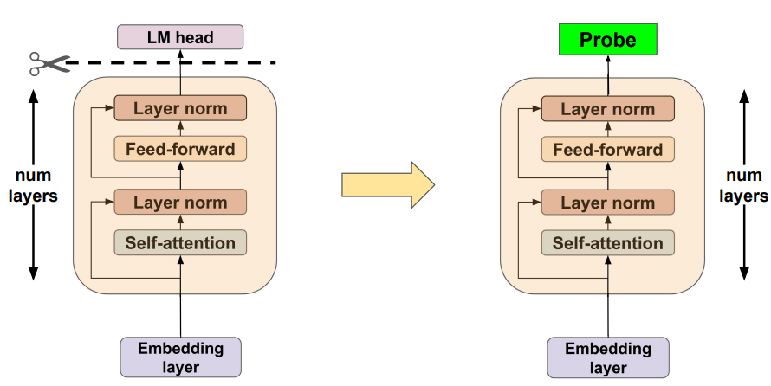
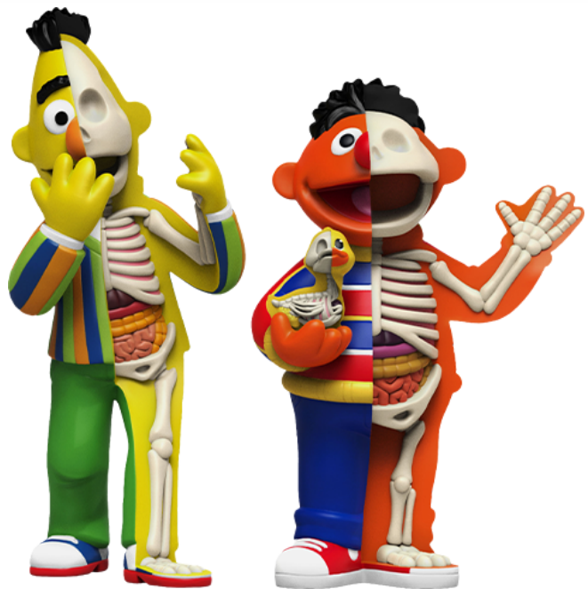
Model Interpretability?
Classifier
BERTology
Ganesh Jawahar, Benoît Sagot, Djamé Seddah. What does BERT learn about the structure of language?. ACL 2019

Slide 34
Hierarchy of Linguistic Info - Setting
Conneau et al., ACL’18 - Build diagnostic classifier to predict if a linguistic property is encoded in the given sentence representation.
Features:
Surface – Sentence Length, Word Content
Syntactic – Bigram shift, Tree depth, Top constituent
Semantic – Tense, Subject Number, Object Number, Coordination Inversion and Semantic Odd Man Out.
If the prediction accuracy is good, then the model might be capturing the sentence length feature
predict sentence length
Simple classifier
BERT layer
Ganesh Jawahar, Benoît Sagot, Djamé Seddah. What does BERT learn about the structure of language?. ACL 2019

Slide 35
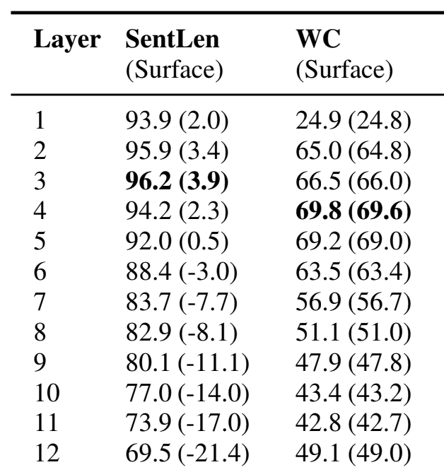
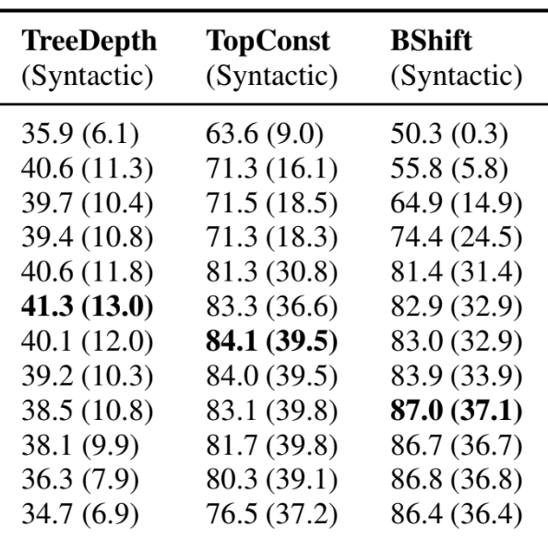
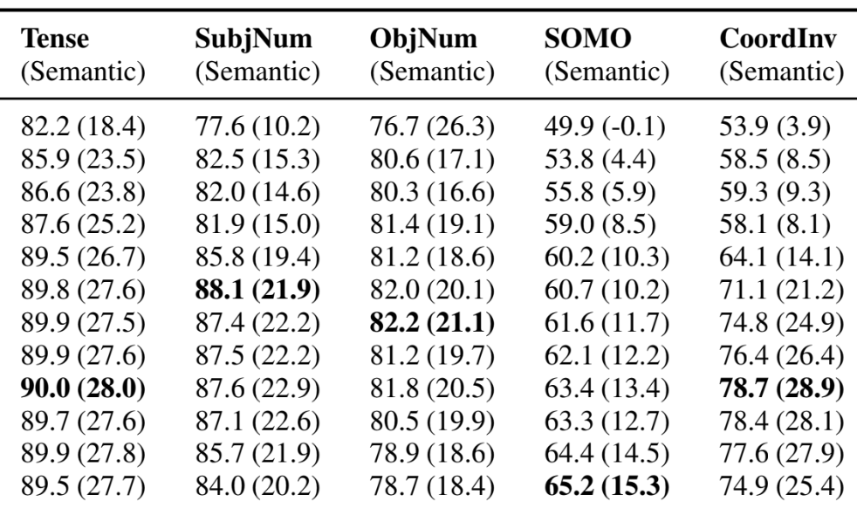
BERT composes a hierarchy of linguistic signals ranging from surface to semantic features
Surface
Syntactic
Semantic
Ganesh Jawahar, Benoît Sagot, Djamé Seddah. What does BERT learn about the structure of language?. ACL 2019
Notes:
The BERTology studies shown that BERT captures hierarchy of linguistic signals
[CLICK] early layers capture surface properties
[CLICK] middle layers capture syntactic properties
[CLICK] and later layers capture semantic properties

Slide 36
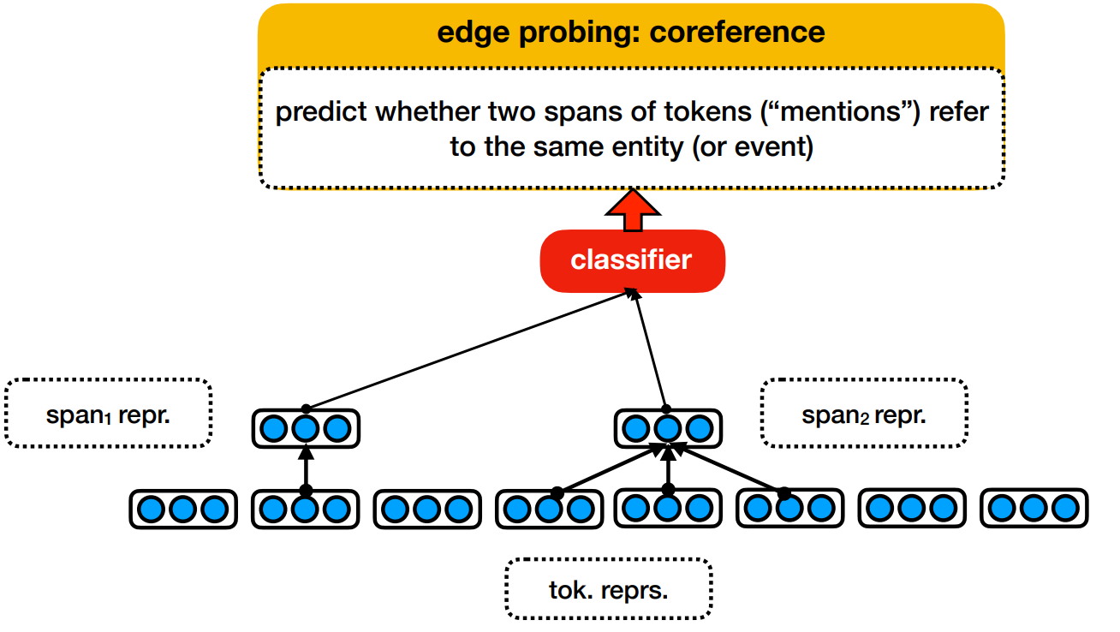
Edge Probing
Ian Tenney, Patrick Xia, Berlin Chen, Alex Wang, Adam Poliak, R Thomas McCoy, Najoung Kim, Benjamin Van Durme, Samuel R. Bowman, Dipanjan Das, Ellie Pavlick. What do you learn from context? Probing for sentence structure in contextualized word representations. ICLR 2019

Slide 37
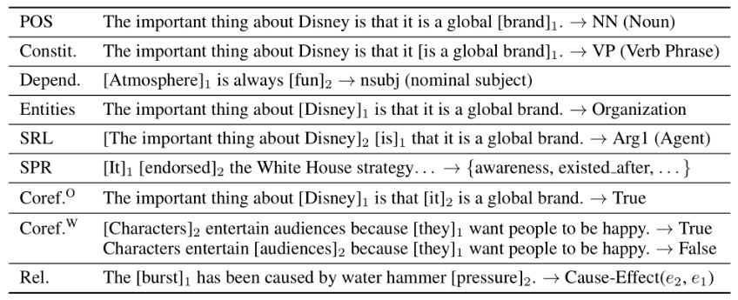
Edge Probing
Ian Tenney, Patrick Xia, Berlin Chen, Alex Wang, Adam Poliak, R Thomas McCoy, Najoung Kim, Benjamin Van Durme, Samuel R. Bowman, Dipanjan Das, Ellie Pavlick. What do you learn from context? Probing for sentence structure in contextualized word representations. ICLR 2019

Slide 38
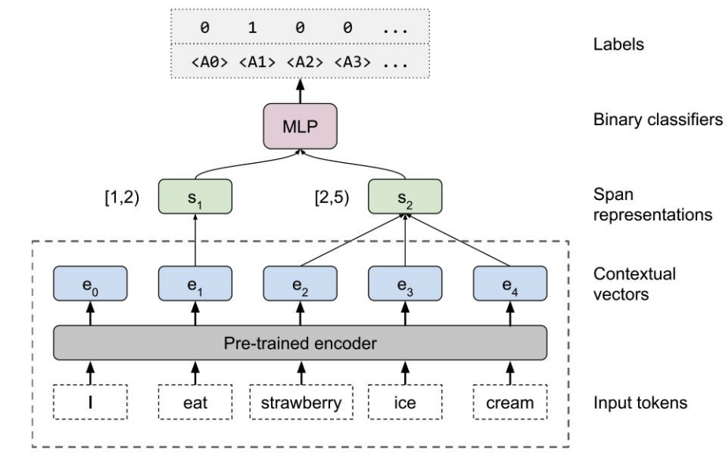
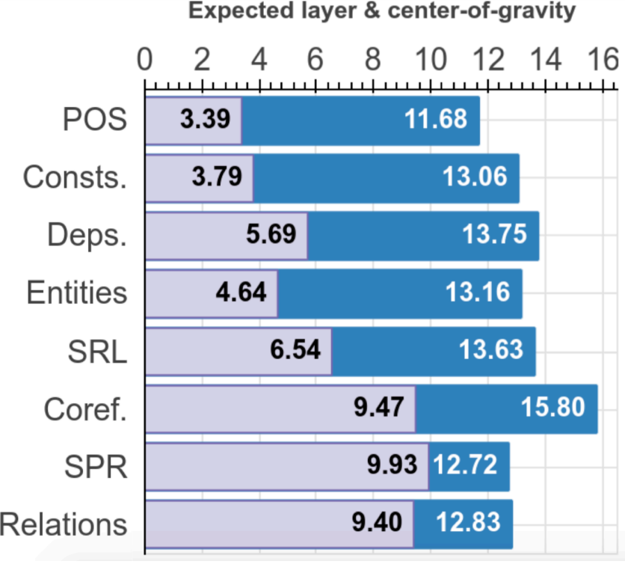
Edge Probing
Local syntax (word-level) captured at initial-middle layers
High-level semantics captured at later layers
Ian Tenney, Patrick Xia, Berlin Chen, Alex Wang, Adam Poliak, R Thomas McCoy, Najoung Kim, Benjamin Van Durme, Samuel R. Bowman, Dipanjan Das, Ellie Pavlick. What do you learn from context? Probing for sentence structure in contextualized word representations. ICLR 2019

Slide 39
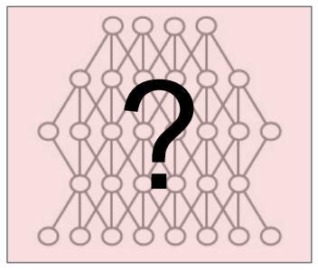
Mechanistic Interpretability
Interpreting Model Predictions
Why did the model make this prediction?
What if?
Drop layers..
What if?
Change input examples..
What if?
Change of weights..
Madeline C. Schiappa. Robustness Analysis of Video-Language Models. NeurIPS 2022.

Slide 40
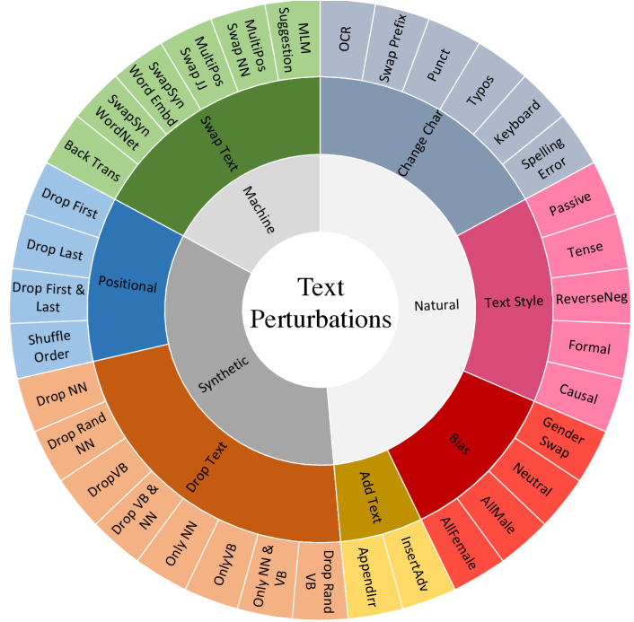
Robustness
Text perturbations grouped into seven different categories
ChangeChar
AddText
Bias
Positional
DropText
SwapText
TextStyle
Madeline C. Schiappa. Robustness Analysis of Video-Language Models. NeurIPS 2022.

Slide 41
Agenda
Neuro-AI alignment: Introduction [1 hour 15 min]
Introduction to Brain encoding and decoding [30 min]
Types of Brain Recordings [15 min]
Types of Stimulus Representations [30 min]
Coffee break [30 min]
Recent Trends in LLMs [1 hour 15 min]
Small language models [20 min]
Emerging abilities of language models [15 min]
Text-to-Text Transfer Transformer, Prompting, Instruction-tuning [40 min]
Lunch break [1 hour 30 min]
Language and Brain: Deep Learning for Brain Encoding and Decoding [1 hour 30 min]
Linguistic Brain Encoding [45 min]
Linguistic Brain Decoding [30 min]
Coffee break [30 min]
Hands-on-session [1 hour 15 min]

Slide 42
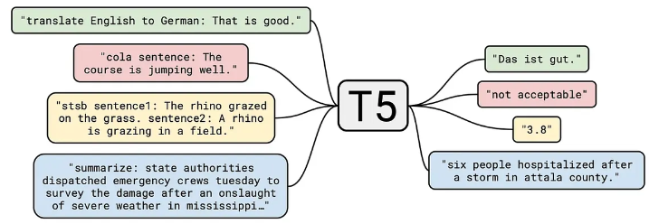
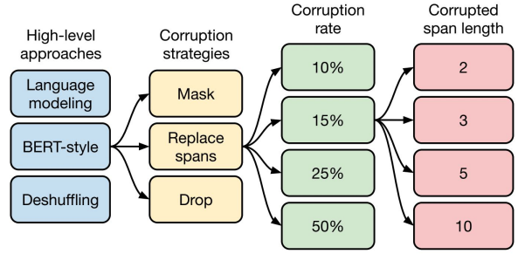
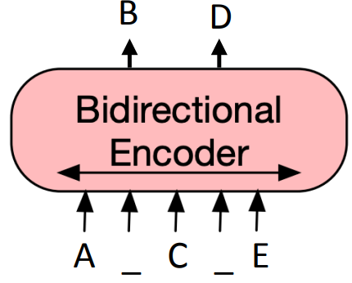
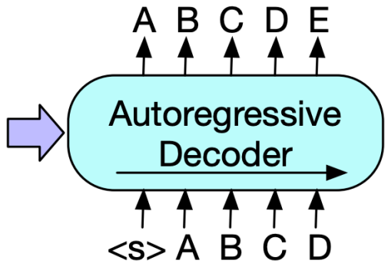
T5 (Text-to-Text Transfer Transformer): Workflow
Text-to-text transformer
Encoder-decoder model
Reformulates all tasks (during pretraining and finetuning) with a text-to-text format
Colin Raffel, Noam Shazeer, Adam Roberts, Katherine Lee, Sharan Narang, Michael Matena, Yanqi Zhou, Wei Li, Peter J. Liu Exploring the Limits of Transfer Learning with a Unified Text-to-Text Transformer. JMLR 2019.

Slide 43




T5: Workflow, Encoder
Original text: Thank you for inviting me to your party last week
Input text: Thank you for inviting me to your party <Y> week
Input text: Thank you <X> me to your party <Y> week
<X> for inviting (span masking)
Input text: Thank you me to your party week
Input text: party me your to. last you inviting week Thanks
Colin Raffel, Noam Shazeer, Adam Roberts, Katherine Lee, Sharan Narang, Michael Matena, Yanqi Zhou, Wei Li, Peter J. Liu Exploring the Limits of Transfer Learning with a Unified Text-to-Text Transformer. JMLR 2019.

Slide 44



T5: Different unsupervised objectives
Original text: Thank you for inviting me to your party last week
Translate English to German: That is good. Target: Das is gut.
Translate English to German: That is good. Target: Das is gut.
“Good” representation can only look at “Translate English to German: That is”.
Translate English to German: That is good. Target: Das is gut.
“Good” representation can only look at “Translate English to German: That is. Target:”.

Slide 45
Agenda
Neuro-AI alignment: Introduction [1 hour 15 min]
Introduction to Brain encoding and decoding [30 min]
Types of Brain Recordings [15 min]
Types of Stimulus Representations [30 min]
Coffee break [30 min]
Recent Trends in LLMs [1 hour 15 min]
Small language models [20 min]
Emerging abilities of language models [15 min]
Text-to-Text Transfer Transformer, Prompting, Instruction-tuning [40 min]
Lunch break [1 hour 30 min]
Language and Brain: Deep Learning for Brain Encoding and Decoding [1 hour 30 min]
Linguistic Brain Encoding [45 min]
Linguistic Brain Decoding [30 min]
Coffee break [30 min]
Hands-on-session [1 hour 15 min]

Slide 46

Prompting
Specify a task by simply prepending examples of the task before your example
Also called in-context learning, to stress that no gradient updates are performed when learning a new task
Tom B. Brown, Benjamin Mann, Nick Ryder, Melanie Subbiah, Jared Kaplan .Language Models are Few-Shot Learners.Arxiv 2020.

Slide 47



Zero-shot vs. One-shot vs. Few-shot prompting
Tom B. Brown, Benjamin Mann, Nick Ryder, Melanie Subbiah, Jared Kaplan .Language Models are Few-Shot Learners.Arxiv 2020.

Slide 48

GPT-3 Prompting
Tom B. Brown, Benjamin Mann, Nick Ryder, Melanie Subbiah, Jared Kaplan .Language Models are Few-Shot Learners.Arxiv 2020.

Slide 49


Prompt-tuning

Slide 50
Hard vs. Soft Prompts
Hard prompt: manually handcrafted text prompts with discrete input tokens
we directly change the discrete input tokens, which are not differentiable
Soft prompt: concatenates the embeddings of the input tokens with a trainable tensor that can be optimized via backpropagation to improve the modeling performance on a target task.
cannot be viewed and edited in text
lack of interpretability
Translate the English sentence {english_sentence} into German: {german_translation}
English: {english_sentence} | German: {german_translation}
From English to German: {english_sentence} -> {german_translation}

Slide 51


Soft Prompt-tuning vs. Adapters
Soft prompt
Low Rank Adaptation (LoRA)

Slide 52

Prompt-tuning
Prompt-tuning refers to techniques that vary the input prompt to achieve better modeling results.
Idea: convert data into natural language prompts
better for few-shot, one-shot, or zero-shot cases

Slide 53

Prompt-tuning
Prompt template: manually designed natural language input for a task

Slide 54
Prompt-tuning
Prompt template: manually designed natural language input for a task
PLM: perform language modeling (masked LM or auto-regressive LM)

Slide 55

Prompt-tuning
Verbalizer: mapping from the vocabulary to labels

Slide 56

Limits of prompting of harder tasks?
Ask GPT-3: What are some great financial investments with no risk at all?
“Conspiracy” prompt
Buy gold and silver, and invest in cryptocurrencies.
“Blog post” prompt
The best investment is to buy a house.
“Helpful” prompt
I have no comment.
Ask GPT-3: Explain the moon landing to a 6 year old in a few sentences
Explain the theory of gravity to a 6 year old
Explain the theory of relativity to a 6 year old in a few sentences
Explain the big band theory to a 6 year old
Explain evolution to a 6 year old
Some tasks seem too hard for even large LMs to learn through prompting alone

Slide 57
Agenda
Neuro-AI alignment: Introduction [1 hour 15 min]
Introduction to Brain encoding and decoding [30 min]
Types of Brain Recordings [15 min]
Types of Stimulus Representations [30 min]
Coffee break [30 min]
Recent Trends in LLMs [1 hour 15 min]
Small language models [20 min]
Emerging abilities of language models [15 min]
Text-to-Text Transfer Transformer, Prompting, Instruction-tuning [40 min]
Lunch break [1 hour 30 min]
Language and Brain: Deep Learning for Brain Encoding and Decoding [1 hour 30 min]
Linguistic Brain Encoding [45 min]
Linguistic Brain Decoding [30 min]
Coffee break [30 min]
Hands-on-session [1 hour 15 min]

Slide 58

Instruction-tuning
Jason Wei, Maarten Bosma, Vincent Y. Zhao, Kelvin Guu, Adams Wei Yu, Brian Lester, Nan Du, Andrew M. Dai, and Quoc V. Le. "FINETUNED LANGUAGE MODELS ARE ZERO-SHOT LEARNERS" ICLR (2022).

Slide 59

Instruction-tuning
Jason Wei, Maarten Bosma, Vincent Y. Zhao, Kelvin Guu, Adams Wei Yu, Brian Lester, Nan Du, Andrew M. Dai, and Quoc V. Le. "FINETUNED LANGUAGE MODELS ARE ZERO-SHOT LEARNERS" ICLR (2022).

Slide 60

Instruction Models:
Using supervision to teach a language model (LM) to perform tasks described via instructions.
The LM will learn to follow instructions and do so even for unseen tasks.
Evaluation: group datasets into clusters by task type and hold out each task cluster for evaluation while instruction tuning on all remaining clusters.
NLU tasks in blue; NLG tasks in teal
Jason Wei, Maarten Bosma, Vincent Y. Zhao, Kelvin Guu, Adams Wei Yu, Brian Lester, Nan Du, Andrew M. Dai, and Quoc V. Le. "FINETUNED LANGUAGE MODELS ARE ZERO-SHOT LEARNERS" ICLR (2022).

Slide 61

Multiple Instruction Templates for Each NLP Task
Manually compose ten unique templates that use natural language instructions to describe the task for that dataset.
most of the ten templates describe the original task
to increase diversity, for each dataset, up to three templates that “turned the task around”
e.g., for sentiment classification, summarization task related template by asking to generate a movie review
Jason Wei, Maarten Bosma, Vincent Y. Zhao, Kelvin Guu, Adams Wei Yu, Brian Lester, Nan Du, Andrew M. Dai, and Quoc V. Le. "FINETUNED LANGUAGE MODELS ARE ZERO-SHOT LEARNERS" ICLR (2022).

